Slide 1
Smart grid communication technologies
Using LoRaWAN infrastructure in a Future Smart Grid
By: Siddhant Khera
Notes:
Welcome to the presentation everybody. I am Siddhant Khera, and for those of you who don’t know me, I usually go by Sid.
The majority of the presentations covered in this class are focusing purely on the HV/Power perspective. I wanted to take a new tangent and talk about something else equally important to us as engineering working in the power industry: talking about a communications backbone infrastructure for future smart grids. Our current grid infrastructure is old and will require incremental updates or a complete overhaul. Knowing how to integrate communication technologies when designing a smart-grid setting in an area is essential.

Slide 2
Today’s Agenda
Background about conventional grid and smart grids
Communication protocols: ZigBee, WiMAX and LoRaWAN
Detailed discussion about LoRaWAN as a potential communications backbone
Closing Discussions
Questions
Notes:
Before we dive in deeper to the communication protocols, let’s talk about what’s on the agenda for today. We start by understanding the conventional grid, and how it compares to a smart-grid. We will then look at LoRaWAN as a protocol that can be used in a smart-grid. Some closing thoughts and some take-aways followed by questions.

Slide 3
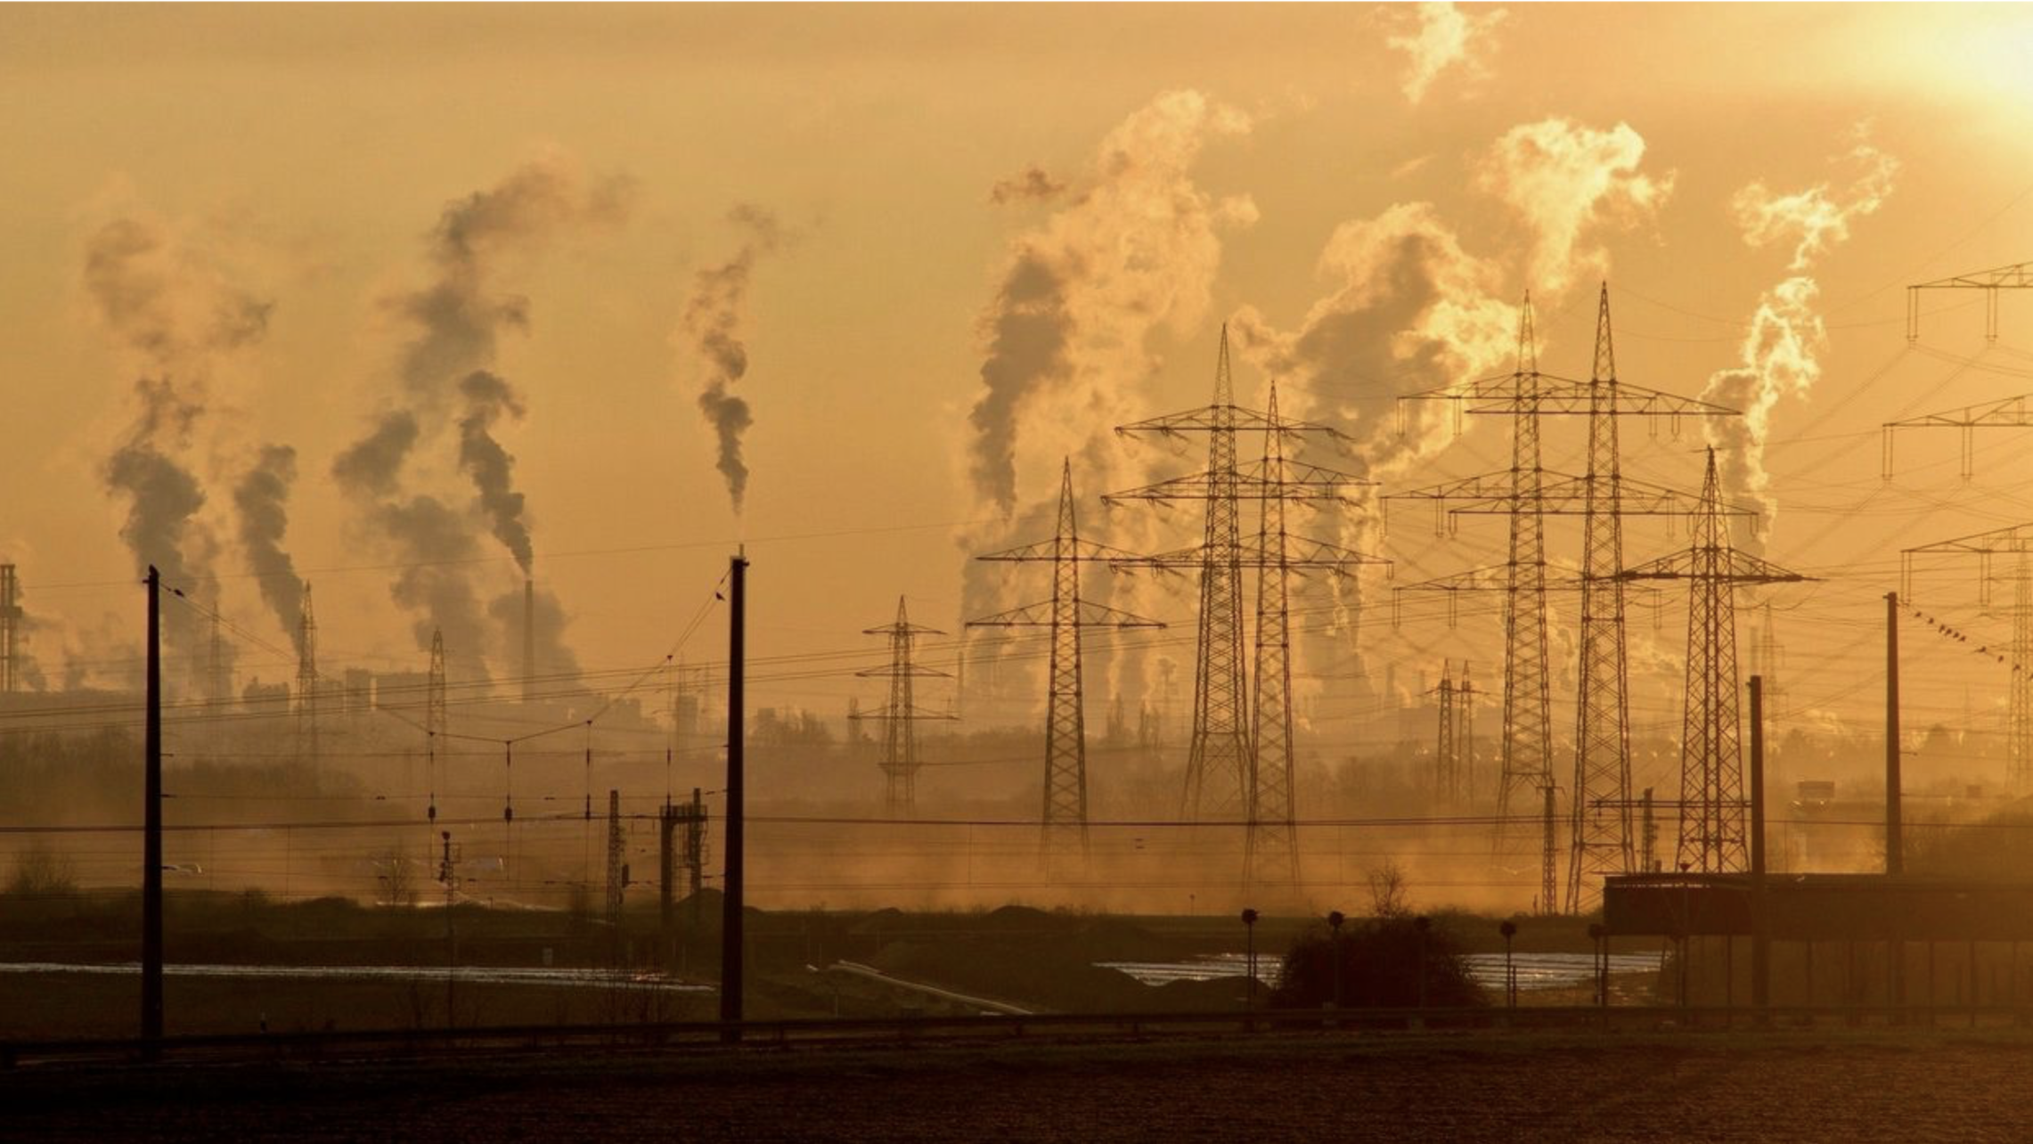
Conventional Grid
Designed in the 1930s [20]
Uni-directional power flow from power generation plant to consumer [6]
Lack of automated analysis, works on how we program generation
Includes fossil-fuel powered generation (coal, gas, etc)
Unable to react quickly to load changes
Overall, these issues have resulted in major blackouts over the past decade [6]
Figure 1: Conventional Grid [8]
Notes:
• Designed in the 19230s as Sean mentioned on Monday, designed to cover small area that we have since scaled to cover the whole country. The system is not transparent and is basically only working on how we program it instead of dynamically based on information. That is why we require extensive planning and maintenance to maintain the grid.
• The legacy grid was built on a principle of unidirectional power flow from the main power plants (that use fossil fuels such as coal, gas and nuclear materials) to the consumers, through the transmission and distribution networks
• Furthermore, the legacy grid suffers lack of automated analysis, slow response to quickly changing load, limited control and poor coordination between generated and consumed energy. Dr. Burke has continually mentioned over the past 8 weeks of the semester about how adding electric vehicles to the current infrastructure is game-changing. Electric Vehicles consume more power than a regular household appliance, and everybody likes to plug in their cars between 5pm to 7pm as soon as they get home. This is a massive power draw and it has the ability to de-stabilize the whole system. De-stabilization leads to blackouts because our current system cannot react fast enough. The problem compounds. This is exactly what we have been discussing throughout the semester.
This resulted in several major blackouts in the past decades.

Slide 4
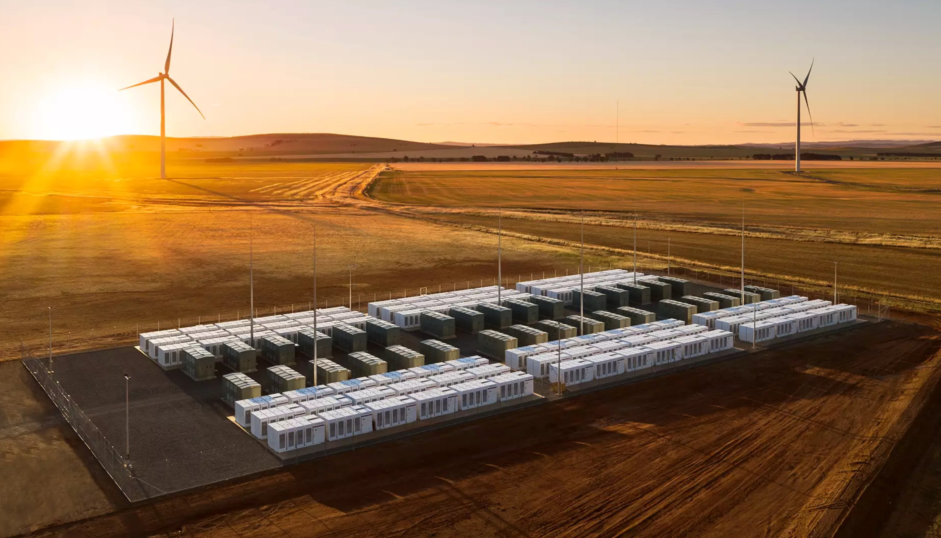
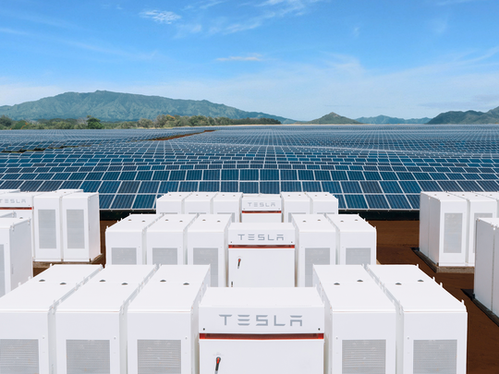
Smart Grid
Primarily uses renewables like Solar, Wind, etc with grid-scale battery storage [18]
Stored energy allows the grid to react within milliseconds to any load changes [19]
Bi-directional communication, exchange of information and power flow
Connected meters, appliances and end-devices allow real-time optimization of the grid with advanced algorithm operations
Grid could be driven by Artificial Intelligence (AI) and Machine Learning (ML) applications
Figure 2: Wind with Grid-Scale Battery [16]
Figure 3: Solar with Battery [5]
Notes:
Lets start by saying that the term “Smart Grid” is more of a market term than a technical one. Pseudo-technically, a “smart-grid” will fully exploit the communications network to cost-efficiently integrate the actions of all direct and indirect users of the load sources, while maintaining low losses and high levels of quality. (Bucher pg. 1)
• Smart grids primarily use renewables like Solar, Wind, etc and a usually more “de-centralized”. Combined with grid-scale battery storage, they can provide real-time stabilization to any sudden load changes in a grid
• Smart-grids also facilitate bi-directional information. So things like an electric car charger at a grocery store could tell a central server that there’s greater load at a location, allowing the algorithms to dynamically manage load and turn off/on power sources
It is a complete software-hardware integration
It can monitor real-time scenarios and forecast operational condition of the grid, diagnose faults and improve system reliability
Interactive, dynamic and real-time pricing instead of at “fixed” off-peak or peak hours. Real-time usage tracking for the user
Economical resource allocation, and supports “plug-and-play” adding of more energy sources that are renewable. Decentralized.
• Examples:
• Meters. Meters can always remain connected to the central server and can provide real-time information to the user and the utility. There could be sensors on all major appliances (high-power consuming) that report the status back to the utility to fine tune power. From our discussion from Monday after Sean’s presentation, these sensors can report back how much inductive power is being used in the home system.
• Status of power generations components. Status of faults in the transmission line. The utility can send commands to temporarily lower the EV charge-rate as a potential way of offering savings to the customer.
• Advantages of a wireless structure as compared to a wired one –– much easier to scale
Biggest of all, with all these sensors reporting back, we can perform advanced data-analytics and start training a Neural Net using Machine Learning to better understand how the power generation needs to be optimized in a given area.
That’s about it for Smart-Grids and why they are better for us

Slide 5
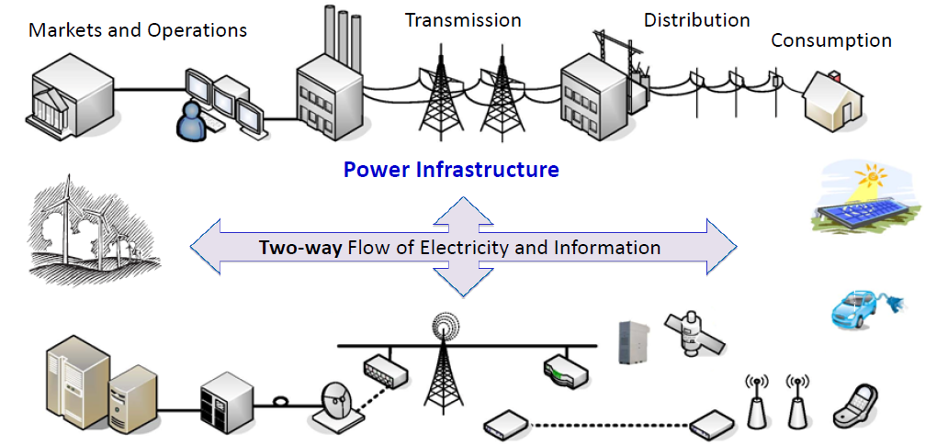
Figure 4: Two-Way Power/Information Flow in a Smart-Grid[14]
Notes:
One thing I haven’t said explicitly, but I have mentioned implicitly a lot is.. Communication. A smart-grid requires a massive backbone communication network.
In the previous slide, we spoke about a two-way communications network that serves as a backbone of a communications network. Here, we see it represented visually. Everything is connected to each other, and there is a central server that is controlling all the resources according to the data obtained by the sensors.
To do all this communication, we need a communications network. Although my presentation has a focus on a particular communication protocol, I would like to briefly mention a couple which are also in active consideration.

Slide 6
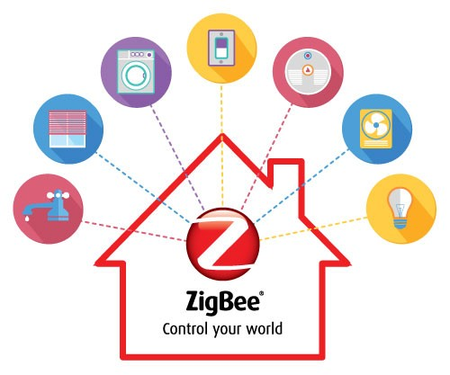

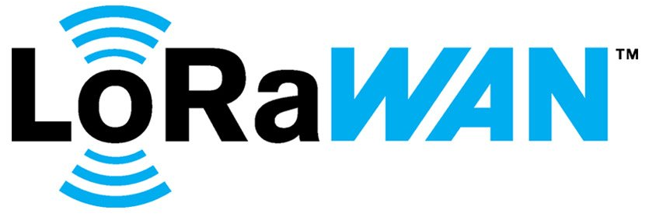
The Good, Better, Best Communication Backhauls
ZigBee
Short range (up to 100m), low-data rate
Medium battery life, prone to interference from WiFi/Bluetooth [6]
WiMAX
Very high data rate (up to 75Mb/s), large range (up to 30 miles), very short battery life [18]
LoRaWAN
Let’s discuss this in detail in later slides
Figure 5: Zigbee Logo [4]
Figure 6: WiMAX Logo [13]
Figure 7: LoRaWAN Logo [15]
Notes:
ZigBee
• based on an IEEE 802.15 standard
• up to 60000 devices to its network
• data rate up to 250bps
• Medium battery life, small memory, low processing rate
• since it operates on 2.4ghz, prone to interference from Wifi networks/Bluetooth due to same frequencies
• interference detection schemes are possible, but they affect battery life
WiMAX
• IEEE 802.16 standard
• Cellular network similar to those above so there is already a well-established network. Easier to deploy in a developed country
• Very high data rate (up to 75mbps)
• Battery life is very short due to it being a cellular network
• For those of you who followed this in 2011-2015 — it was touted as a long range wifi replacement

Slide 7
LoRaWAN –– Long Range Wide Area Network
Uses license-free Industrial, Scientific and Medical (ISM) bands [11]
Long range, very long battery life
Variable data rate available (from 290bps to 50kbps) [11]
Primarily ALOHA based, Listen Before Talk recently researched [6]
Based on Chirp Spread Spectrum [11]
Uses a Star Topology which ultimately prolongs battery life [10]
Secured via AES-128 end-to-end encryption [10]
Highest link budget, at 154dB, among all standardized IEEE communication technologies [12]
Notes:
I purposely held off on introducing this just yet, including completing the acronym for you guys. The acronym will fit in the understanding better now that the basis of this presentation is clear.
LoRaWAN uses license-free Industrial, Scientific, and Medical (ISM) bands which are free to use for anybody without paying any fees. Great examples here are Bluetooth and Wifi, which is used at 2.4Ghz and 5Ghz range around the world. LoRaWAN uses different frequencies around the world (NA, EU, AU, ASIA). All of them are under 1Ghz so shorter frequencies lead to a larger range.
It is also primarily ALOHA based, which we will talk about later. Listen Before Talk is a recent implementation that improves the amount of collisions in the network which will also be discussed with ALOHA.
It has a very long range, up to 30 miles or hundreds of square miles. Entire cities can easily be covered. It also has ultra high battery life, at up to 8 years depending on the mode it is used in.
CSS and star topology both improve battery life and range, and we will discuss them in detail later.
The link budget, typically given in decibels (dB), is the primary factor in determining the range in a given environment and it is the highest for LoRaWAN
Let’s talk about these technical details and let’s by talking about ALOHA and LBT

Slide 8
ALOHA vs Listen Before Talk (LBT)
ALOHA
Simple communications scheme in which the device sends data at the scheduled time-slot without scanning the channel [3]
Listen Before Talk
Encoding scheme where the device scans the channel before transmitting [6]
If channel is busy, then the device waits for [0,2^{BE} −1]
BE is the back-off exponent that goes from [m_{min},m_{max}]
ALOHA + Listen Before Talk
Simulations proved that LoRaWAN has least collisions when 50% nodes transmit based on ALOHA and 50% on Listen Before Talk [6]
Notes:
ALOHA
Pure Aloha: The device just sends whenever it has it scheduled to So in the case of Class A devices, it would just send the data whenever it wants to
Think of it like you are talking to someone else and he/she just starts speaking whenever they want to. You’ll tolerate it. But what happens when 100 others in the same room do the same thing? The quality goes down and there’s too much “noise” -- likewise happens in network communications. There are lots of collisions and lost packets.
Slotted Aloha: devices can only send frames in assigned slots. If the packet is lost or if the device is unable to send the frame, it must wait till the next slot. LoRaWAN uses both.
Listen Before Talk
LBT makes it possible for other users to share a common channel. When LBT is enabled, the device will check that the channel is available before transmitting a packet.
If m_max is exceeded due to repeated collisions, then the message is discarded and then device waits for the next uplink window

Slide 9
ISM Bands and Regions
North America
902Mhz to 928Mhz [17]
Europe
863Mhz to 870Mhz [12]
0.1% to 1% Duty Cycle when running ALOHA protocol [17]
No duty cycle limitation when using Listen Before Talk protocol [6]
Australia
915Mhz to 928Mhz [12]
Asia
Definition in Progress by Technical Committee [12]
Notes:
NA: Dedicated uplink and downlink channels
EU: Common uplink and downlink channels, duty cycle limitation. Essentially devs need to be more careful with their payloads in EU. LBT helps avoid interference and congestion in EU
AU: Similar to US, uplink frequencies are a little higher since it starts at 915Mhz instead of 902Mhz
ASIA: Korea, Japan, China, and India are still in process of defining the frequencies they would like to give to LoRaWAN.
China is leaning towards 700Mhz and 500Mhz, some channels blocked for their electric utility and not available for public use

Slide 10
Classes of Devices
Class A
Must send uplink transmission during scheduled time intervals, like ALOHA, followed by two short downlink transmission windows [3]
If either window is missed, must wait for next one
Implementing Class A is mandatory in LoRa end-devices
Class B
Downlink transmission can be received during scheduled time intervals, no need for prior uplink transmission [3]
Class C
Always listening for downlink transmission, except when during uplink transmission [3]
Notes:
Class A
Device must send an uplink transmission first before it can receive a downlink. The uplink transmission is scheduled. There are two open receive windows after a successful uplink transmission. This is the most common one.
Class B
Downlink transmission can be scheduled, no need for a poor uplink
Class C
• Receiving at all times unless during an uplink transmission

Slide 11
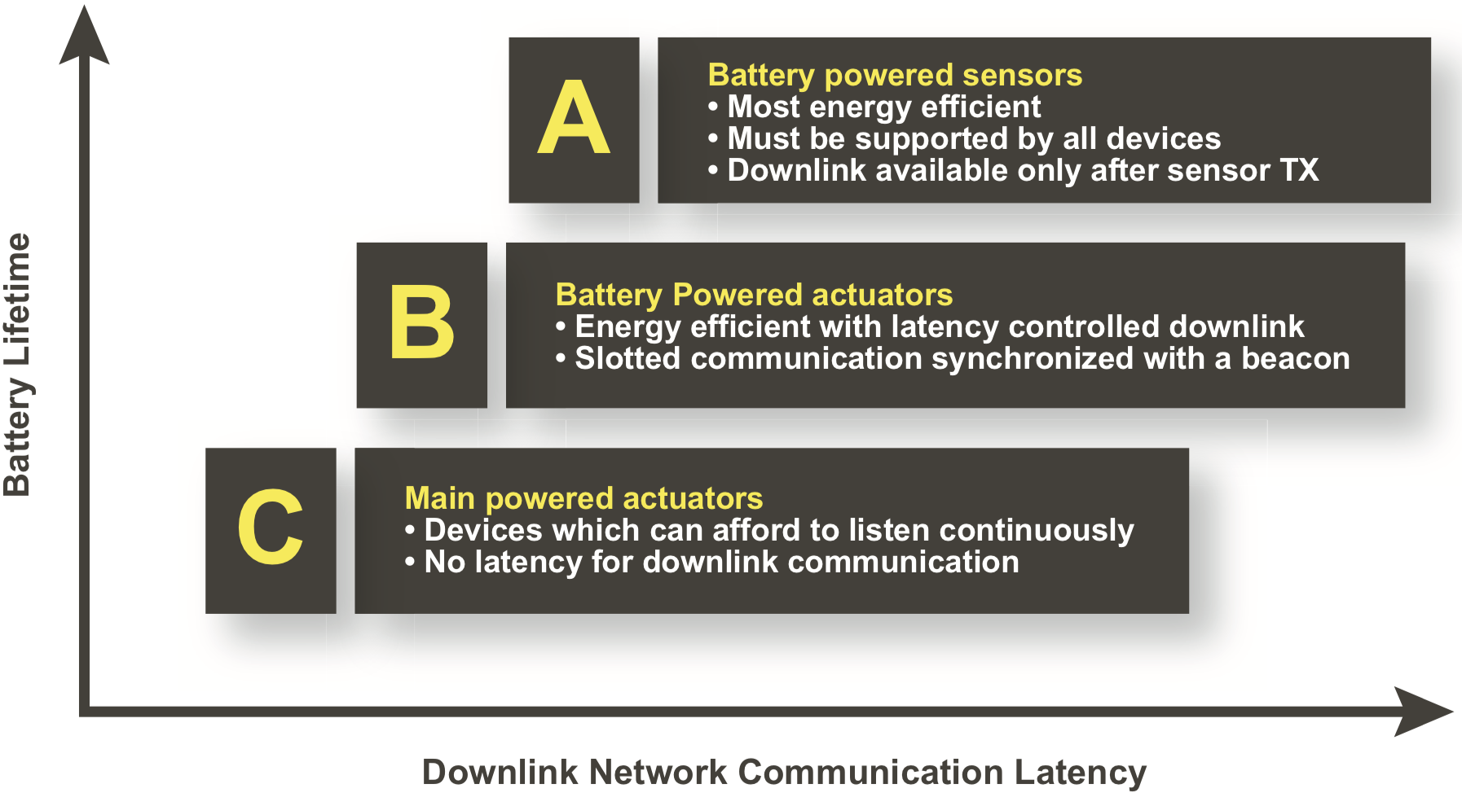
Summary of Classes of Devices
Figure 8: Visual Representation of Different Classes of Devices [12]
Notes:
Explain the graph

Slide 12
Spreading Factor (SF) and Range
Spreading Factor (SF)
Spreading Factor is used to define the communication distance as well as the data rate of the transmission [1]
Generally, increasing the SF means a lower data rate but a longer range
Spreading Factor (SF) | Data Rate (bps)
7 | 11,000
8 | 6,100
9 | 3,400
10 | 2,000
11 | 1,100
12 | 400
Table 1: SF vs Data Rate [1]
Notes:
The spreading factor (SF) is a configuration parameter of the modulation techniques defined as the ratio between the symbol rate and chip rate. The number of chips per symbol is calculated as 2^{SF}, thus the SF tells “how much” the reference signal is spread in time; the higher the spreading factor the longer the transmission range but the lower the transmission rate; indeed, each increase in SF halves the transmission rate and, hence, doubles transmission duration and ultimately energy consumption; LoRa specifications define a discrete set of usable spreading factors from SF = 7 to SF = 12.

Slide 13
Transmission Power and Battery Life
Transmission Power
Transmission Power (Tx Power) is directly proportional to battery consumed
Higher SFs, which result in greater range, require higher Tx Power
Increasing bandwidth within the same SF does not have an effect on battery life [17]
Characteristic Triangle
Lower Range and Higher Data Rate
Higher Range and Lower Data Rate
Lower Tx Power
Higher Tx Power
Lower SF
Higher SF
Notes:
So if Tx power is high, the battery life will be shorter.
This is the Tx power, SF, and Range triangle. Note that Range and data-rate are directly affected by the SF. The Tx power is indirectly affected by the SF chosen. In a lower SF, the data rate can still be higher if a higher bandwidth is chosen. LoRaWAN supports bandwidths 125khz, 250khz and 500khz

Slide 14
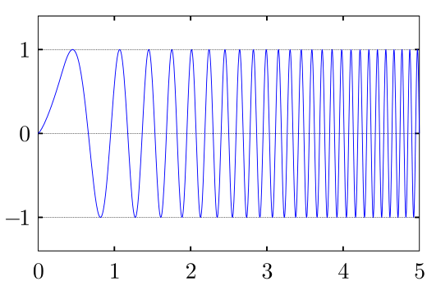
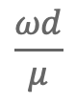
Chirp Spread Spectrum (CSS)
LoRa modulation (the PHY layer) uses CSS
A technique that uses chirp signals in a linear FM signal to transmit whole bandwidth
Doppler Effect Time Shift is:
T_{d} = [2]
ω_{d} is the angular frequency shift by Doppler Effect
μ is the chirp rate of the message signal
Since μ is high in LoRa, effect Doppler time shift is primarily minimized [6]
$$\frac{ωd}{μ}$$
Figure 9: Up-Chirp FM Wave [6]
Notes:
Chirp stands for 'Compressed High Intensity Radar Pulse’ . Chirp signals have constant amplitude and transmit whole bandwidth in a certain time. CSS is a technique that uses chirp signals in a wideband frequency
Frequency lowest to highest is up-chirp, highest to lowest is down-chirp
Doppler Effect is when the source of a wave is moving relative to an observer, and the observer receives a frequency different from the one that radiated by the source
It is defined as angular frequency shift divided by chirp rate.
Doppler Effect can also cause auto-correlation peak on the receiver, causing it to shift in time
Since chirp rate is high, time shift is minimized.

Slide 15
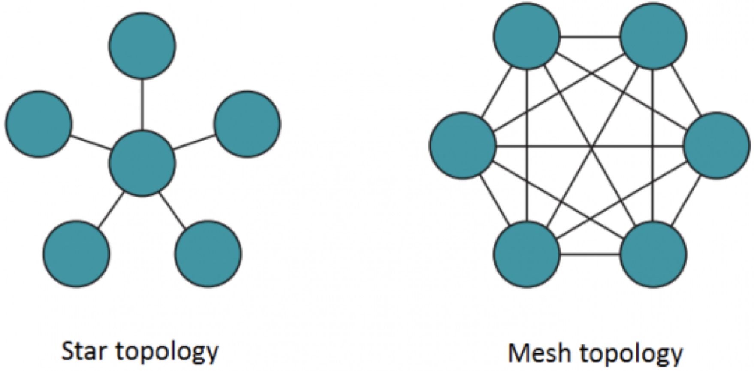
Star Topology vs Mesh Topology
Star Topology
All communication is directly between the end-node and the gateway
Maintains battery-life
Reduces range compared to Mesh
Mesh Topology
Individual end-nodes forward information to other nodes to increase communication range
Adds complexity
Reduces network capacity
Reduces battery lifetime
Note: All end-nodes only contact the gateway.
Note: Any one of these end-nodes could act as a gateway.
Figure 10: Star and Mesh Topology[7]
Notes:
LoRaWAN uses star topology. All end-nodes can only communicate with a gateway. They do not have inter-end-nodes communication system. While this reduced the possible range, it maintains the battery life because there is less complexity.
On the other hand, in a mesh topology, individual end-nodes can communicate amongst each to forward the message to another component in the system. It increases range but adds complexity to the system which ultimately reduces battery life. It reduces battery lifetime as nodes receive and forward information from other nodes that is likely irrelevant for them
Long range star architecture makes the most sense for preserving battery lifetime when long-range connectivity can be achieved – which we can get with LoRaWAN

Slide 16
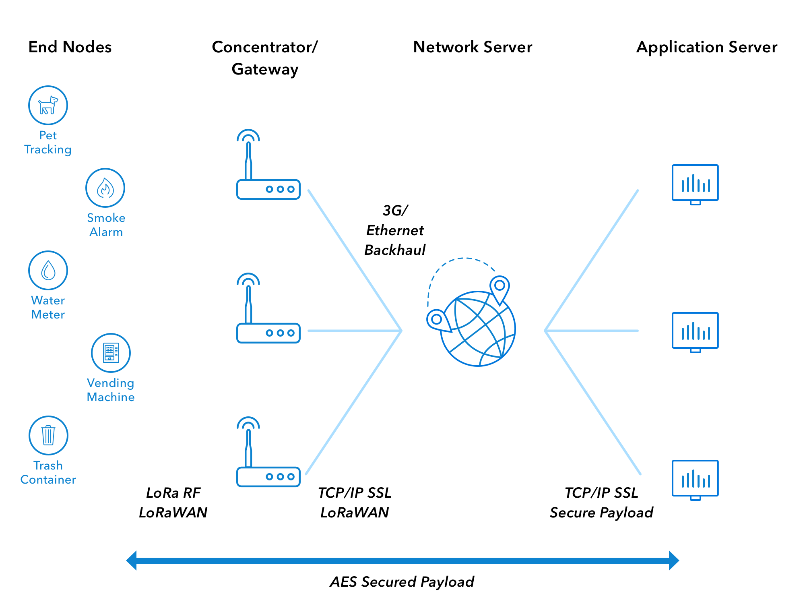
General Network Architecture
The end-nodes are not attached to a single gateway [17]
Any gateway can connect to the end-node
Processing occurs at the Application Server
Network Server is a basic internet/intranet backhaul to facilitate connection between Gateway/Application Server
Figure 11: LoRaWAN Network Infrastructure[17]
Notes:
Interestingly, end-nodes are not attached to a single gateway unlike Zigbee, and they also don’t need to wake up and synchronize themselves as they would need to in WiMAX. Since all end-nodes can connect to all gateway’s in a given system, it makes the whole ecosystem much more modular.
Adds redundancy
Allows truly mobile sensors to retain battery-life
Opens up opportunity for more application in smart-grids
Finally:
A whole smart-grid ecosystem can be created where every primary devices (appliances directly connected to the grid) and tertiary devices (devices indirectly connected to the grid, portable ones) can connect to and pass on information about their status.
A mobile car update the gateway about it status of charge and hourly data over a period of time can be analyzed by a neural net to automatically predict and prepare the grid
Having a mobile long range sensor opens up a lot of possibilities, and it is one of the reasons why we would benefit more in the long-term by having s widespread LoRaWAN network

Slide 17
Summary
Smart-grids can benefit from a communication backhaul that can host an entire ecosystem of devices for analysis and tracking
LoRaWAN has crucial benefits and can assist in diverse applications:
Characteristic | LoRaWAN
Data Rate | 290bps to 250kbps
Battery-Life | Up to 8 Years
Range | Up to 35 Miles/Node
Topology | Star on Star
Security | AES-128 Encryption
Table 2: Major LoRaWAN Characteristics [9]
Notes:
To summarize, smart-grids should fully utilize any communications backhaul. We can create an entire ecosystem of devices powered by the grid instead of just having a connected power grid.
LoRaWAN is an excellent candidate for this application. These characteristics along with a gateway-agnostic approach streamlines a future ecosystem of smart-connected devices to grid

Slide 18
References
[1] A. Lavric and V. Popa. A LoRaWAN: Long range wide area networks study. In 2017 International Conference on Electromechanical and Power Systems (SIELMEN), pages 417–420.
[2] Alessio Sanfratello. Enabling relay-based communication in LoRa networks for the In- ternet of Things: design, implementation and experimental evaluation. IEEE Commu- nications Magazine, 55(9):34–40, 2019.
[3] F. Adelantado, X. Vilajosana, P. Tuset-Peiro, B. Martinez, J. Melia-Segui, and T. Wat- teyne. Understanding the limits of loRaWAN. IEEE Communications Magazine, 55(9):34–40, 2017.
[4] Buildyoursmarthome.com, https://buildyoursmarthome.co/reviews/best-zigbee-controllers/
[5] Cleantechnica.com, https://cleantechnica.com/2018/01/11/wind-solar-storage-prices-smash-records/
[6] D. Baimel, S. Tapuchi, and N. Baimel. Smart grid communication technologies- overview, research challenges and opportunities. In 2016 International Symposium on Power Electronics, Electrical Drives, Au- tomation and Motion (SPEEDAM), pages 116–120.
[7] Dspace.cvut.cz, https://dspace.cvut.cz/bitstream/handle/10467/76315/F3-BP-2018-Semanova-Lucia-bp-luciasemanova.pdf?sequence=-1&isAllowed=y
[8] Ecowatch.com, https://www.ecowatch.com/fossil-fuel-industry-deceived-public-2641052019.html?rebelltitem=1
[9] J. de Carvalho Silva, J. J. P. C. Rodrigues, A. M. Alberti, P. Solic, and A. L. L. Aquino. Lorawan — a low power WAN protocol for Internet of Things: A review and opportunities. In 2017 2nd International Multidisciplinary Conference on Computer and Energy Science (SpliTech), pages 1–6.

Slide 19
References
[10] Juha Petäjäjärvi, Konstantin Mikhaylov, Marko Pettissalo, Janne Janhunen, and Jari Iinatti. Performance of a low-power wide-area network based on LoRa technology.
[11] Konstantin Mikhaylov, Juha Petaejaejaervi, and Tuomo Haenninen. Analysis of capacity and scalability of the lora low power wide area network technology. In European Wireless 2016; 22th European Wireless Conference, pages 1–6. VDE.
[12] LoRa-Alliance, https://lora-alliance.org/sites/default/files/2018-04/what-is-lorawan.pdf
[13] Lifewire.com, https://www.lifewire.com/wimax-wireless-networking-818321
[14] Quora.com, https://www.quora.com/What-is-smart-power-grid
[15] Smartparkingsystems.com, https://smartparkingsystems.com/wp-content/uploads/2018/03/Logo-LoRa-WAN.jpg
[16] Teslarati.com, https://www.teslarati.com/tesla-powerpack-farm-australia-energy-storage-movement/
[17] TheThingsNetwork.com, https://www.thethingsnetwork.org/docs/lorawan/
[18] V. C. Gungor, D. Sahin, T. Kocak, S. Ergut, C. Buccella, C. Cecati, and G. P. Hancke. Smart grid technologies: Communication tehnologies and standards. IEEE Transactions on Industrial Informatics, 7(4):529–539, 2011.
[19] V. C. Gungor, D. Sahin, T. Kocak, S. Ergut, C. Buccella, C. Cecati, and G. P. Hancke. A survey on smart grid potential applications and communication requirements. IEEE Transactions on Industrial Informatics, :28–42, 2013.
[20] Wikipedia.org, https://en.wikipedia.org/wiki/Electrical_grid#History

Slide 20
Questions?
Notes:
I would be happy to take any questions

